Slide 1


Clinical characterization of the cancer treatment using the Oncology CDM
2020-03-11
Hokyun Jeon, Seng Chan You MD, MS, Rae Woong Park MD, PhD

Slide 2
Backgrounds
Unlike the cancer registry data, EHR does not contain chemotherapy information as a machine-readable record, making it difficult to extract.
In EHR-based databases, chemotherapy records can be extracted and loaded through NLP or algorithm, then can be included in the EPISODE table of the oncology extension model.

Slide 3
Objective
The episode includes :
a record of consecutive chemotherapy
A record of each chemotherapy session (called 1 cycle) is included
The Episode_event contains the drug_exposure_id of the drug records that are related to the episode record.

Slide 4
Objective
Treatment Line
FOLFOX
Episode
Treatment Cycle
1st
2nd
3rd
4th
5th
6th
Episode
event
Single medication
5Fu
+
Leucovorin
+
Oxaliplatin
Drug exposure
Therefore, we extracted chemotherapy information to make it possible to seamlessly identify
Treatment line level records of chemotherapy
Treatment cycle level records
A single drug level records from episode tables.

Slide 5
Objective
Based on the extracted chemotherapy records, the patterns of treatment were identified and visualized.
In addition, a proof-of-concept study was conducted to identify onset timing of the adverse event (Neutropenia).

Slide 6

Study Methods
In the process of extracting the episode table and episode event for chemotherapy, we referred to regimen descriptions in the HemOnc database.

Slide 7
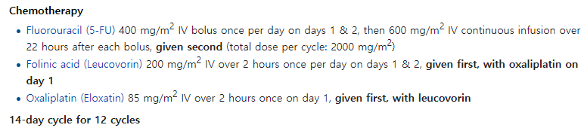
Study Methods
The description of each chemotherapy in HemOnc can be summarized as:
What combination of drugs each chemotherapy regimen consists of
How many days the interval between chemotherapy is maintained.

Slide 8
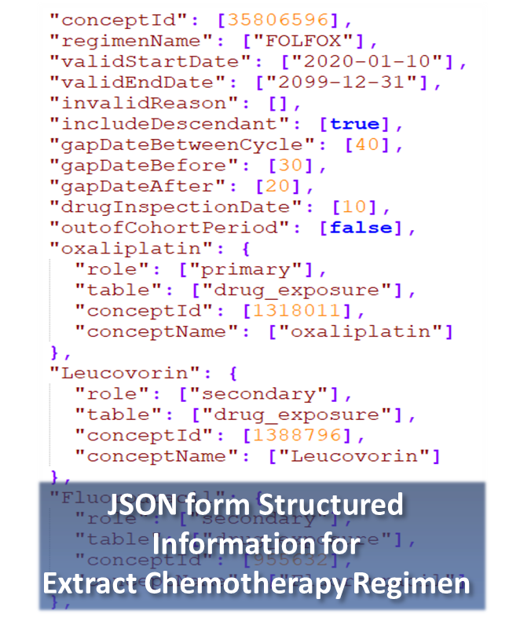
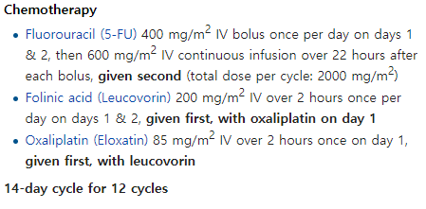
Study Methods
We generated a machine-readable JavaScript Object Notation (JSON) structure to utilize 1,506 regimen descriptions in HemOnc for extracting chemotherapy records.

Slide 9
Study Methods
Based on this information, it was possible to identify drug combinations corresponding to each regimen, and to set date criteria for judging identical series of treatment when generating records for each cycle unit.

Slide 10
Study Methods
This JSON file structure is easy to reflect modifications and changes, allowing for continuous updates and customization.

Slide 11
Study Methods
The JSON file contains the following information.
(1) Ingredient concept_id of combination drugs in each regimen
(2) The interval between different drug_exposure_start_date that considered to be a combination therapy
(3) The interval between chemotherapy start date which is considered as a series of chemotherapy
The extraction package is designed to leverage these information as parameters.

Slide 12
Study Methods
a
b
c
Regimen A is combination of a, b and c :
Primary drug (dispense date)
Primary drug (dispense date)
a
b
c
In the JSON file, one of the combination drugs of each therapy is defined as a primary drug. The algorithm finds and indexes the dispense date of each primary drug.

Slide 13
Study Methods
a
b
c
Regimen A is combination of a, b and c :
Drug inspection period
(from regimen descriptions in JSON )
Secondary drug
a
b
c
Secondary drug
The package checks whether other drugs in the combination (secondary drugs) were used within a drug inspection period based on the dispense date of the primary drug.

Slide 14
Study Methods
Regimen A
Regimen B
a
b
c
a
b
c
d
‘d’ is Excluded drug for Regimen A
There may be confusion if the drug condition of one regimen is included in a drug combination of another regimen.
Therefore, we added drug condition that should not be included by defining Excluded drug in each regimen description.

Slide 15
Study Methods
a
b
c
Regimen A is combination of a, b and c :
EPISODE Table
Episode start date
 | Episode_source_ concept_id | Episode_ Number | Episode_start_ Datetime | Episode_end_ datetime
FOLFOX | 35804199 | 1 | 2005-10-14 | 2005-10-14
FOLFOX | 35804199 | 2 | 2005-11-14 | 2005-11-14
FOLFOX | 35804199 | 3 | 2005-12-12 | 2005-12-12
a
b
c
Episode end date
After testing for drugs that meet the conditions, the earliest drug exposure start date and latest drug exposure date for the combination of drugs are entered as start and end date for chemotherapy episode.
This is considered as a single chemotherapy record.

Slide 16
Study Methods
a
b
c
Regimen A is combination of a, b and c :
Episode start date
EPISODE Table
a
b
c
 | Episode_source_ concept_id | Episode_ Number | Episode_start_ Datetime | Episode_end_ datetime
FOLFOX | 35804199 |  | 2005-10-14 | 2005-12-12
Gap date range
(from regimen descriptions in JSON )
Episode end date
If the interval between chemotherapy records falls within a gap date range, it is considered a series of treatments, and the start date of the earliest chemotherapy record and the end date of the last chemotherapy are considered as an episode start date and an end date of the treatment line.
Then, treatment line level episode is also generated.

Slide 17
Study Methods
The ID of each combination drug was linked to each episode_id in the episode event table.
The extracted records were validated by manual comparison with medical reports of randomized 300 patients treated FOLFOX, FOLFIRI, and XELODA.
We compared the types of chemotherapy regimen received and the number of chemotherapy iterations (cycle number) in each patient.

Slide 18
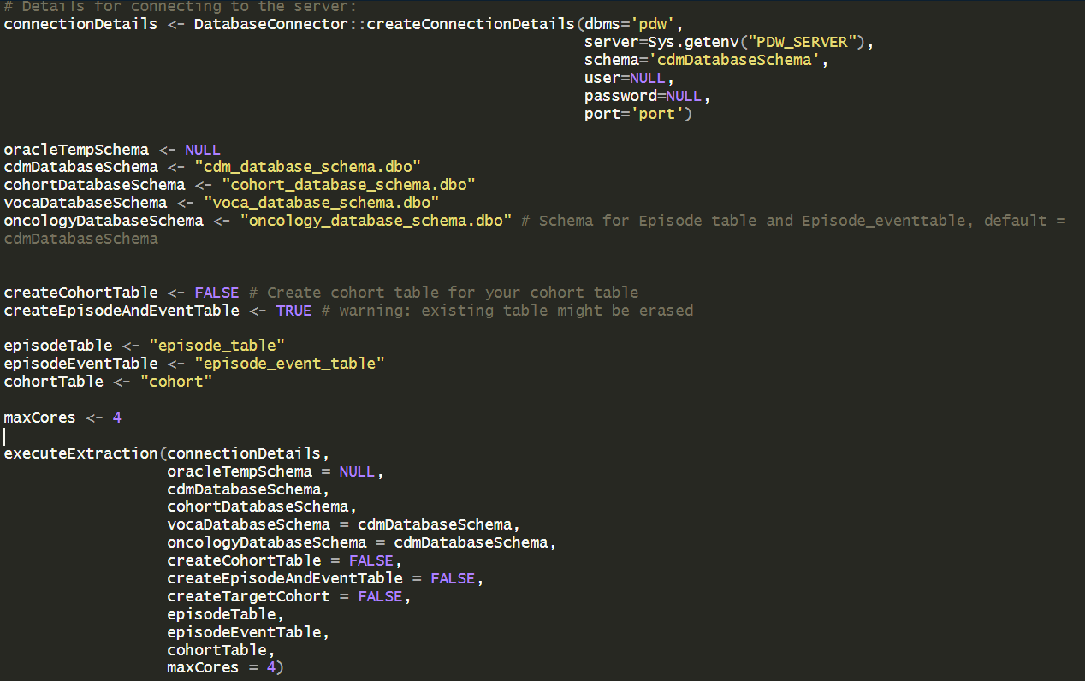
Study Methods
After entering the database information and executing the function,
the episode table and episode event table would be created in the DB.

Slide 19
Study Methods
When the regimens are chosen from the extracted chemotherapy data, the visualization tool operates based on cohort records.
In this process, it is necessary to provide information about the cohort to the visualization tool.

Slide 20
Study Methods
If a user enters cohort definition id, cohort name, category, and regimen concept id of each regimen in the ‘CohortDescription.csv’ file included in the package, a cohort for each regimen is created in your database.
Cohorts for surgery and neutropenia events should be created separately by the user. Also, these information should be entered in the csv file.

Slide 21
Study Methods
After you have completed the cohort setup and made some figure settings in the visualization tool, you can run the visualization results.
Visualization results of treatment patterns obtains :
A graph of the usage patterns of chemotherapy regimen per year
A flow chart for the treatment pathway including surgery and chemotherapy
The heatmap for distribution of the patients for chemotherapy iteration number

Slide 22
Study Methods
As a proof-of-concept study, We visualized neutropenia event with Absolute Neutrophil Count (ANC) levels below 2000 mm³. The visualization result for Event (neutropenia) is as follows.
A histogram that shows how many chemotherapy cycles patients received before the first neutropenia onset.
A graph of the date of the first neutropenia onset from the first chemotherapy. In order to ignore the temporary neutrophil decreasing due to chemotherapy, the neutropenia events occurred 2 days back and forth from the date of chemotherapy is treated.

Slide 23
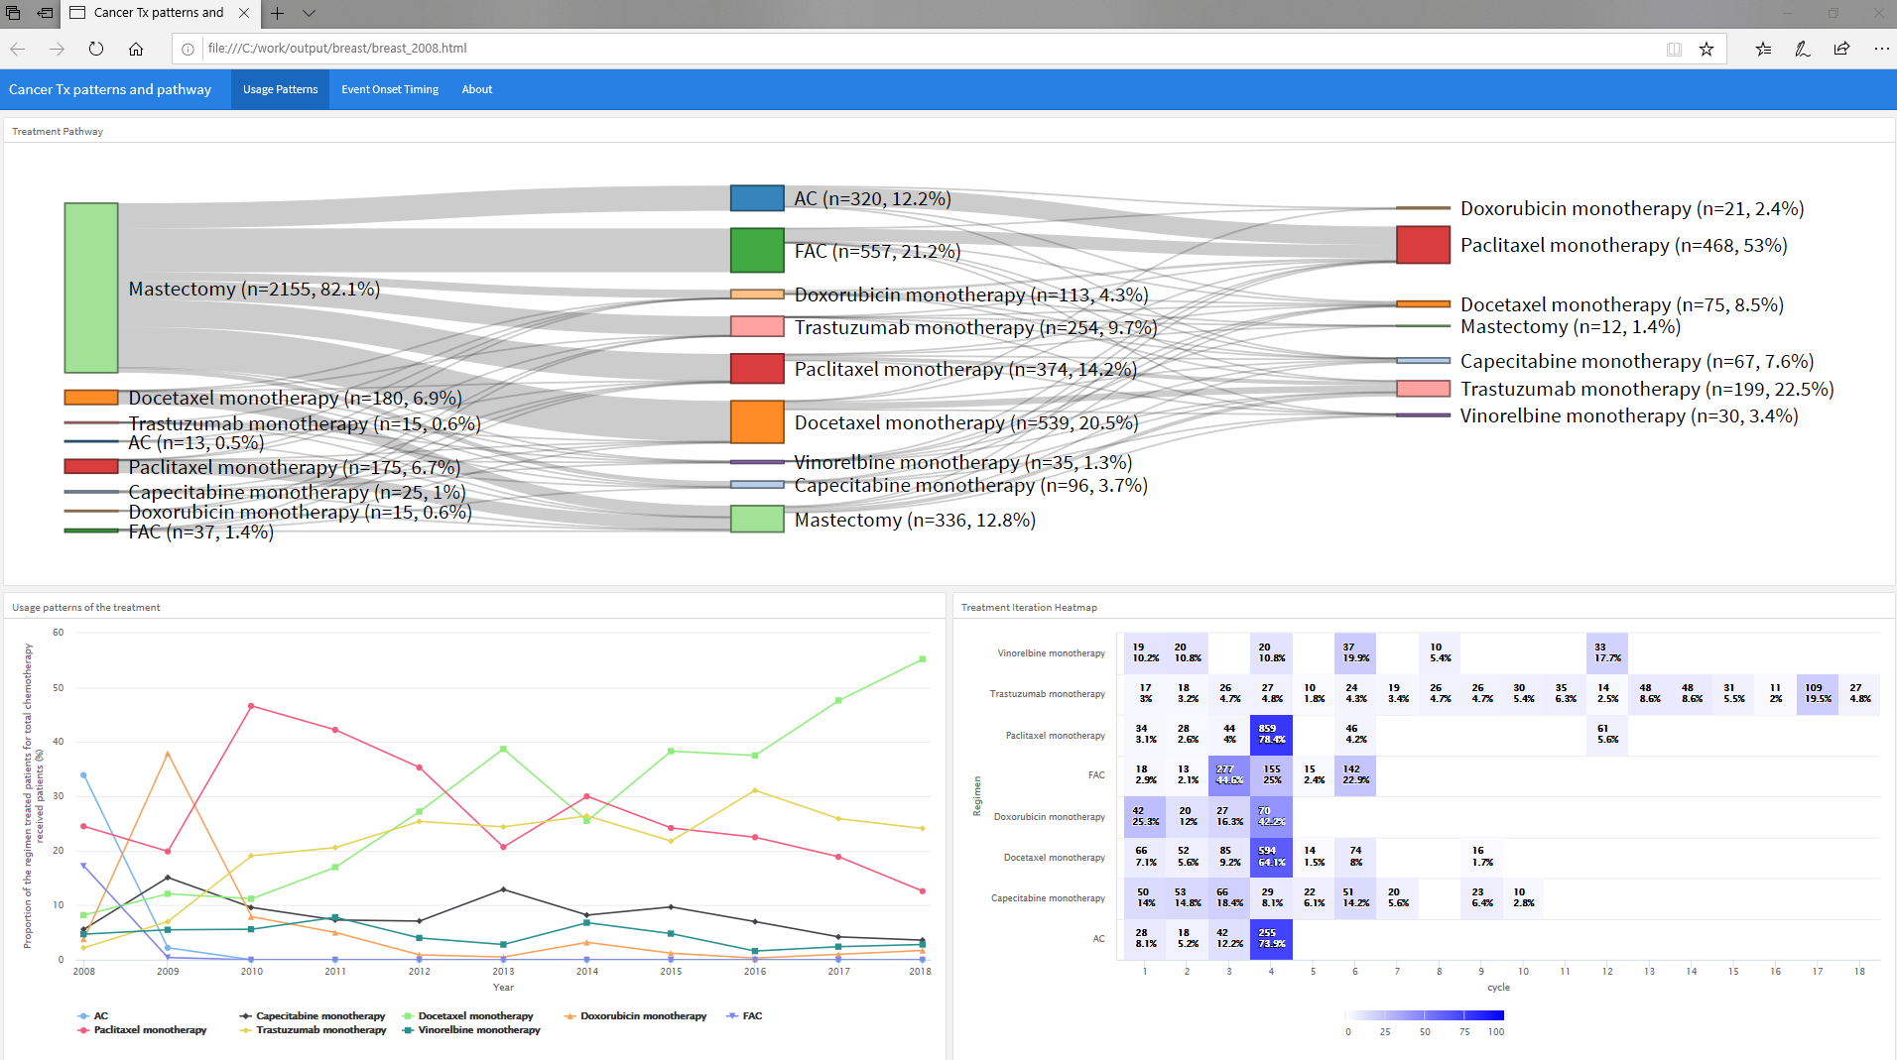
Study Methods
All visualization results are interactive figures that can be viewed in a single html file.

Slide 24
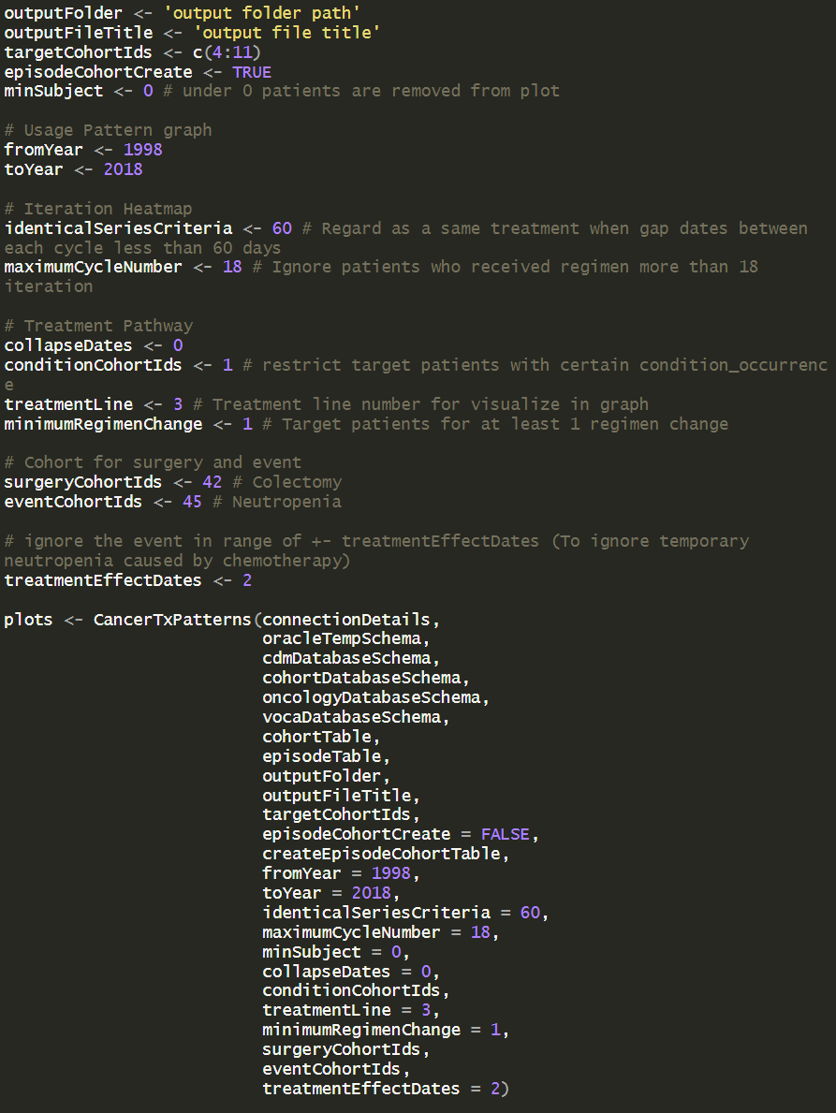
Study Methods
After setting detailed parameters related to visualization, when executing the following function, the visualization result is saved as html and metadata for plot in the output folder.

Slide 25
Study Methods
Data sources
Database : Ajou University School Of Medicine (AUSOM) CDM database
Chemotherapy record extraction target patients : Colorectal cancer patients (n= 10,197), Breast cancer patients (n= 9,546), Lung cancer patients (n= 12,671)
Visualization target regimen : 8 most common chemotherapy regimens in each cancer type.
Breast cancer regimen
AC
FAC
Trastuzumab monotherapy
Capecitabine monotherapy
Doxorubicin monotherapy
Paclitaxel monotherapy
Docetaxel monotherapy
Vinorelbine monotherapy
Colorectal cancer regimen
Fluorouracil and Folinic acid
FOLFOX
Capecitabine monotherapy
FOLFIRI
FOLFOX4 and Bevacizumab
CapeOx
FOLFIRI and Bevacizumab
FOLFIRI and Cetuximab
Lung cancer regimen
Gemcitabine monotherapy
Gefitinib monotherapy
Pemetrexed monotherapy
Carboplatin and Paclitaxel
Vinorelbine monotherapy
Docetaxel monotherapy
Carboplatin and Gemcitabine
Cisplatin and Pemetrexed

Slide 26
Study Results
Table 1. The overall accuracy table of the extract chemotherapy records compared to information in clinical note
Treatment regimen | No information In clinical notes (cases) | Regimen type positive predictive value (%) | Iteration number comparison Accuracy (%) | Iteration number difference average | Iteration number Root Mean Squared Error (RMSE)
FOLFOX | 8 | 100 | 87.0 | 0.3 | 0.64
FOLFIRI | 21 | 100 | 88.6 | 0.4 | 1.36
XELODA | 65 | 100 | 69.0 | 0.65 | 1.5
This is a table showing accuracy compared the chemotherapy records extracted by the algorithm to chemotherapy information identified from the clinical reports.
The types of chemotherapy matched exactly, and the iteration number of treatments was exactly matched in 81.5% of cases.

Slide 27
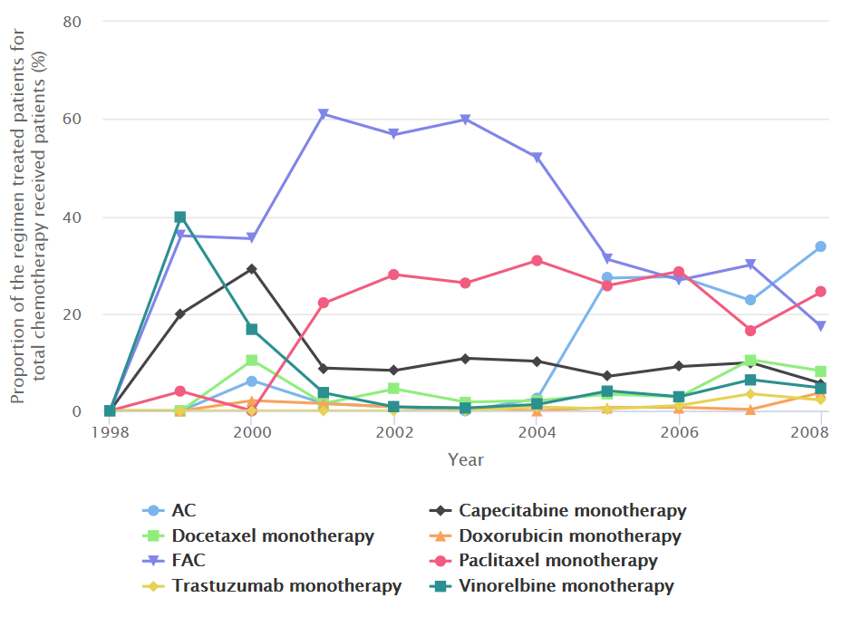
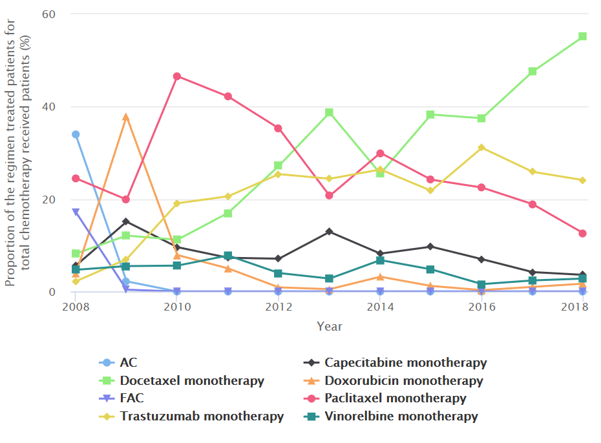
Study Results
(a)
(b)
Figure 1. The usage patterns for each chemotherapy regimen in patients with breast cancer by year
This graph shows the usage patterns of chemotherapy regimen by year. The proportion of the number of patients using specific chemotherapy to the patients receiving chemotherapy is shown on the y axis. This graph can help you identify which chemotherapy uses are increasing or decreasing by year.

Slide 28
Study Results
(a)
(b)
Figure 1. The usage patterns for each chemotherapy regimen in patients with breast cancer by year
(a) shows the chemotherapy usage pattern for breast cancer patients from 1998 to 2008 and (b) shows from 2008 to 2018. The graph represents that FAC regimen has been widely used in the past 10 years (1998 ~ 2008), but the use of Docetaxel therapy has gradually increased in recent 10 years (2008 ~ 2018).

Slide 29
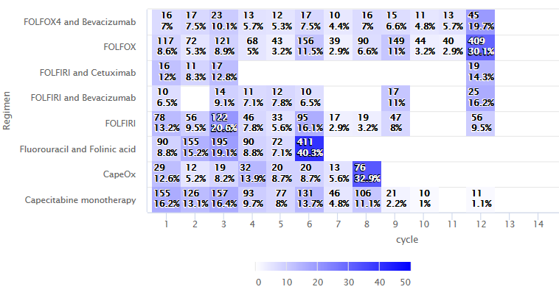
Study Results
Figure 2. Heatmap showing the number of patients by number of treatment iteration in colorectal cancer
This chart shows the number of patients in each repeated number of treatment in colorectal cancer. The darker the color, the higher the number of patients are distributed. In the example of FOLFOX regimen, most of patients have received 12 cycles, which is consistent with the standard number of iteration recommended in HemOnc.

Slide 30
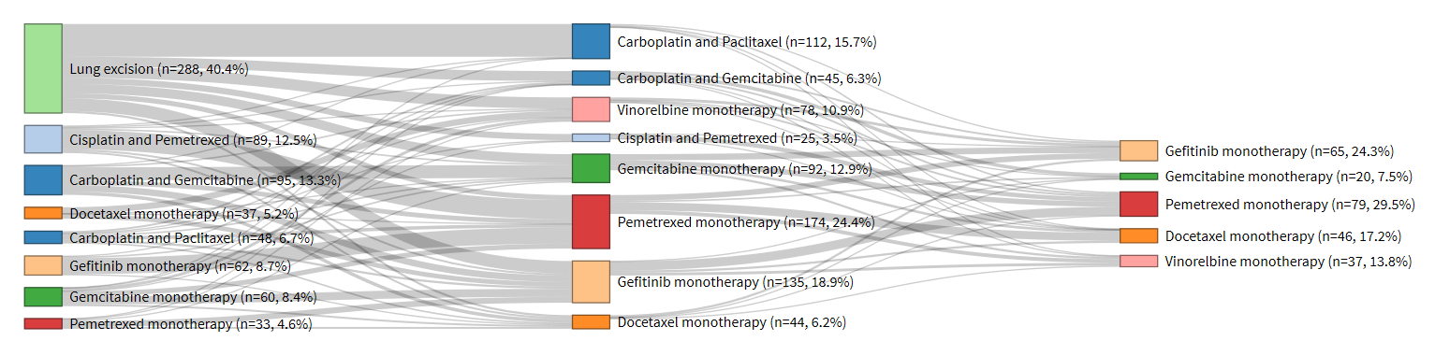
Study Results
Figure 3. A flow chart representing the treatment pathways according to treatment lines in lung cancer patients
This flow chart shows the number of patients in each treatment type by treatment line. The chart represents the pattern of the treatment change in patients including surgery records. Most people who have had lung surgery receive ‘Carboplatin and Paclitaxel’ as an adjuvant chemotherapy.

Slide 31
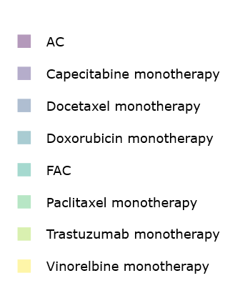
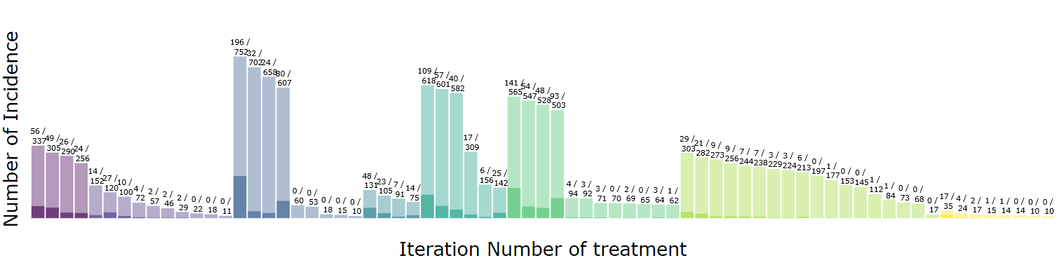
Study Results
Figure 4. The proportion of the number of patients with neutropenia onset in each chemotherapy by treatment cycle in breast cancer
Histogram showing how many cycles of chemotherapy were taken until neutropenia occurred for each regimen. The light bars represent the total number of patients treated and the dark bars represent the number of patients with neutropenia.

Slide 32
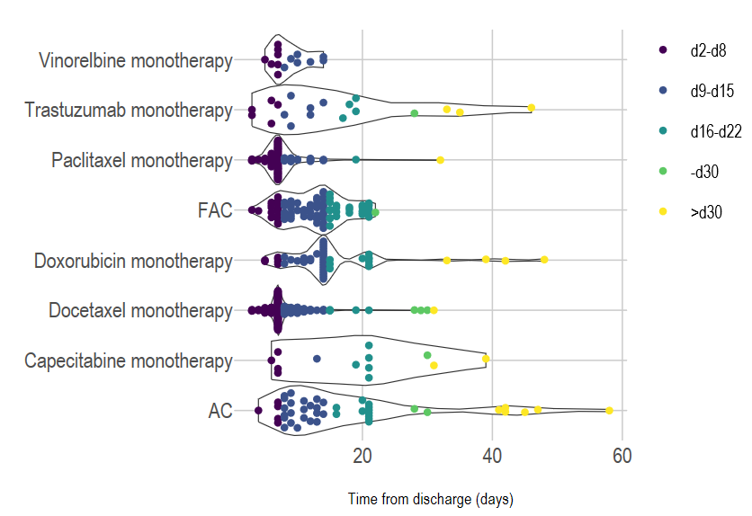
Study Results
d7
d14
Figure 5. Time distribution of neutropenia onset after first chemotherapy in breast cancer
The chart shows, by date, the time that neutropenia develops after the first treatment for each chemotherapy. In most breast cancer chemotherapies, neutropenia occurs in d7.

Slide 33
Limitations
When extracting chemotherapy records, it is difficult to distinguish chemotherapy with the same drug conditions.
There is a lack of validation in other cancer types except colorectal cancer for the results of chemotherapy extraction.
The identification of treatment patterns does not reveal information about radiation therapy.
Adjuvant and neo-adjuvant therapy were not clarified to identify treatment patterns.

Slide 34
Conclusions
We suggested the extraction method for chemotherapy regimen from Electronic Health Records or the other database which is deficient in chemotherapy regimen data.
We are going to validate this algorithm results in breast cancer, and in the other CDM database.
Based on extracted chemotherapy regimen data, we demonstrated the treatment pathway and patterns of cancer patients.
Also, we suggested the neutropenia onset timing analysis as a proof-of-concept study.
All the codes are uploaded on GitHub page (https://github.com/ohdsi-studies/CancerTxPathway).

Slide 35
Thank you for listening !

